Slide 1



sample superstore report practice
View in Power BI
Last data refresh:
7/19/2022 2:24:41 AM UTC
Downloaded at:
7/24/2022 2:37:23 AM UTC

Slide 2
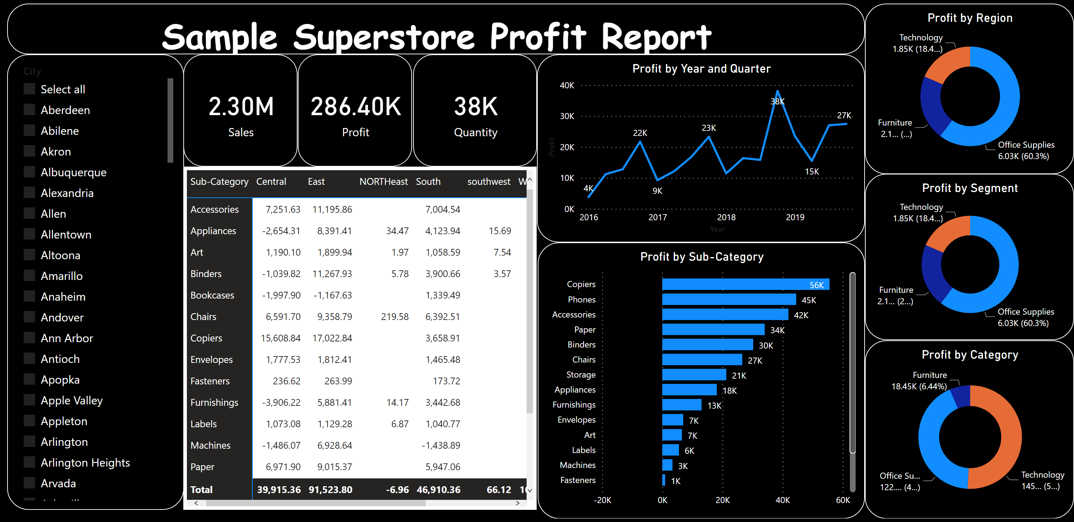
Sample Superstore Report
Notes:
Sample Superstore Profit Report
No alt text provided
donutChart
No alt text provided
Profit by Segment
No alt text provided
Profit by Region
No alt text provided
barChart
No alt text provided
lineChart
No alt text provided
slicer
No alt text provided
pivotTable
No alt text provided
card
No alt text provided
card
No alt text provided
card
No alt text provided

